Slide 1
NIKE SALES ANALYSIS
SME: Abhi Saklecha
TRAINER: Dinesh Karthik
PRESENTED BY:
SAGAR CHAUDHARI (GL)
ARUN (GL)
SAI KUMAR SAPARE
SHIVANI KAPPATI
VAIBHAV SINGH
DHARUN BALAJI

Slide 2
OUTLINE
Overview
Data cleaningusing Pandas
IICS Task
Snowflake task
Tableau Visualizations
Burndown Chart
Kanban Chart
Conclusion

Slide 3
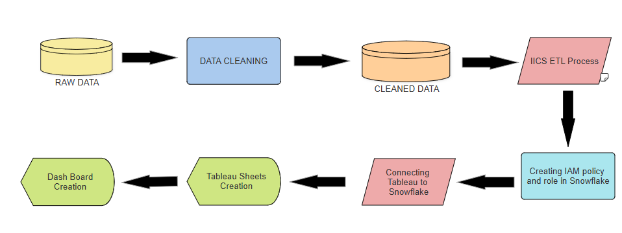
FLOWCHART

Slide 4
OVERVIEW:
Data cleaning involves handling missing values, removing duplicates, fixing data types, renaming columns etc.
We will extract and load data from an Oracle Database to Snowflake using Informatica Intelligent Cloud Services (IICS).
Unload the data from Snowflake to an AWS S3 bucket.
Create an IAM role in AWS for auto-ingestion in Snowflake
Visualize the Snowflake data using Tableau for creating insightful reports.

Slide 5
DATA CLEANING :
In Jupyter Notebook, we performed data cleaning using the Pandas library. The steps performed include:
Dropping Unnecessary Columns: Specific columns such as SKU, SKU_VARIANT, COLOR_CODE, TID, and PRODUCT_URL are removed from the Data Frame to focus on relevant data.
Replacing Values: We used the df.replace() function to replace the string value "6 (EU 39)" with the integer 6 in our Data Frame.
Changing Column Name: we used the df.rename(columns={"old_column_name": "new_column_name"}, inplace=True) function to change the column name from “Department" to “Sections" in Data Frame.

Slide 6
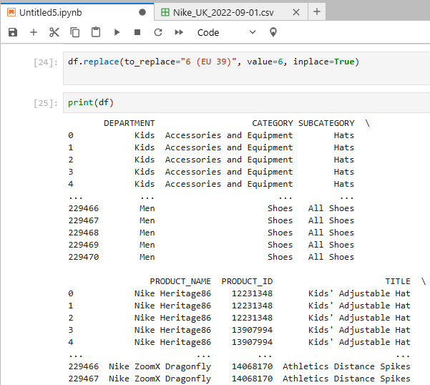
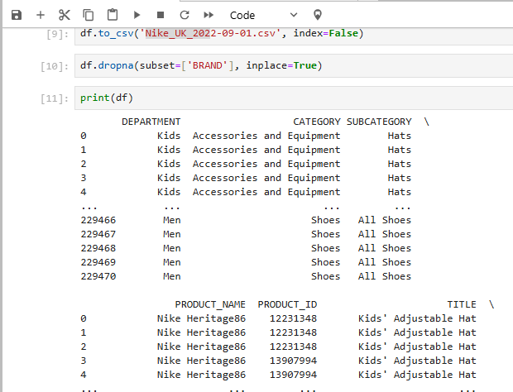
Snapshots

Slide 7
IICS TASK:
We used a Nike sales dataset and employed Informatica Intelligent Cloud Services (IICS) to map the data.
Oracle served as the source, and Snowflake was the target for data integration.
This task involved extracting data from Oracle using IICS and loading the data into Snowflake.
An email task was added in IICS to trigger an email notification upon the successful completion of the mapping task.

Slide 8
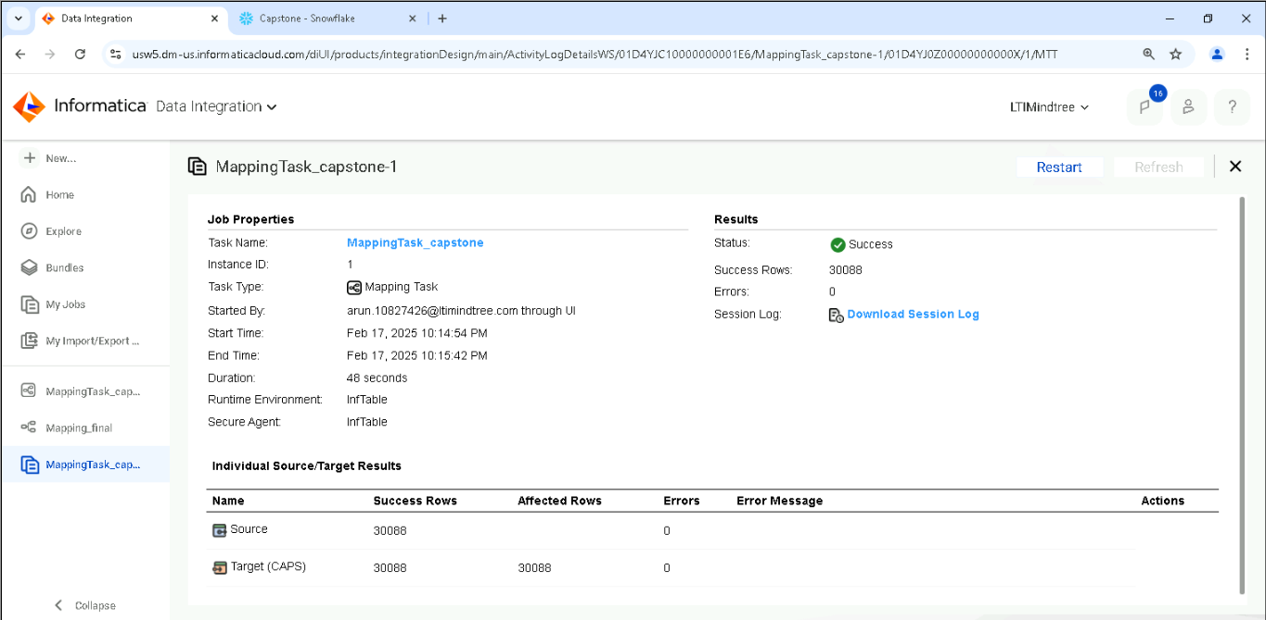
Snapshots:

Slide 9
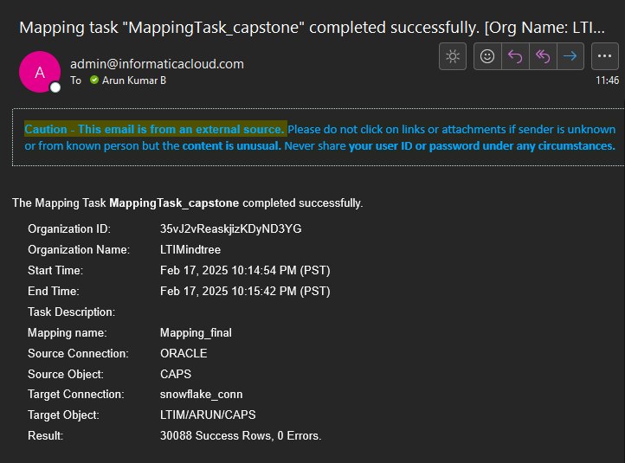
Email notification upon the successful completion of the mapping task.

Slide 10
SNOWFLAKE TASK:
Once the data was loaded into Snowflake, we proceeded to unload it into AWS S3.
This involved generating an IAM policy in AWS with the necessary permissions, creating an IAM role, and establishing a secure storage integration between Snowflake and AWS S3.
The data has been shared to everyone in the team through private sharing.

Slide 11
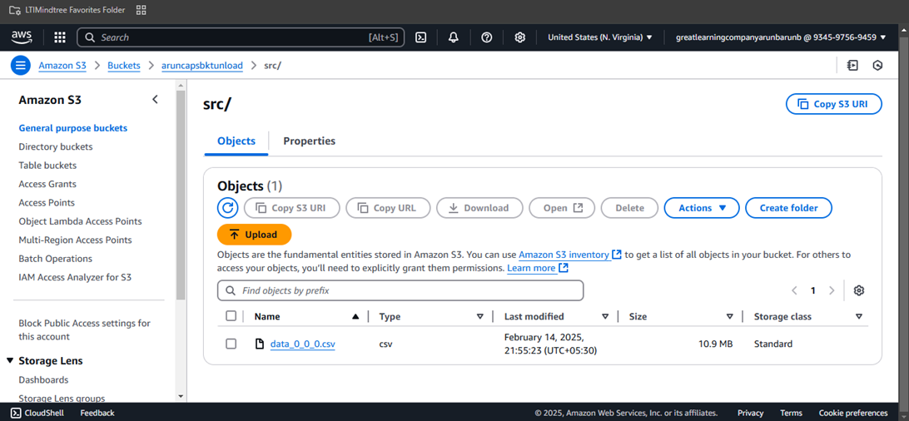
Snapshots:
Unloaded Data File :

Slide 12
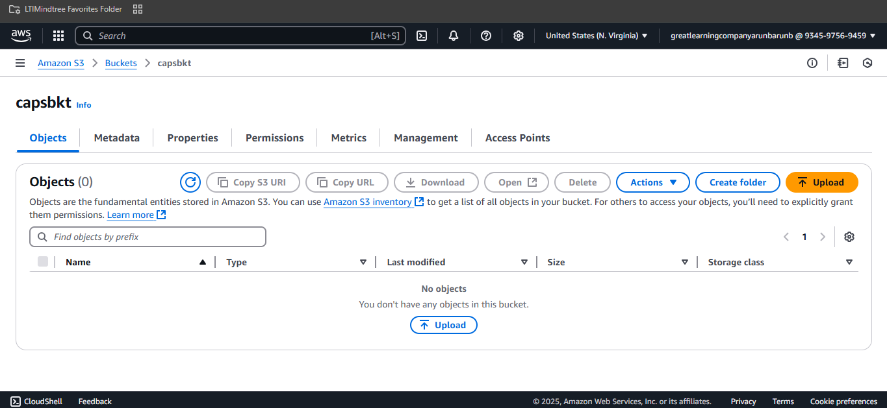
Bucket creation

Slide 13
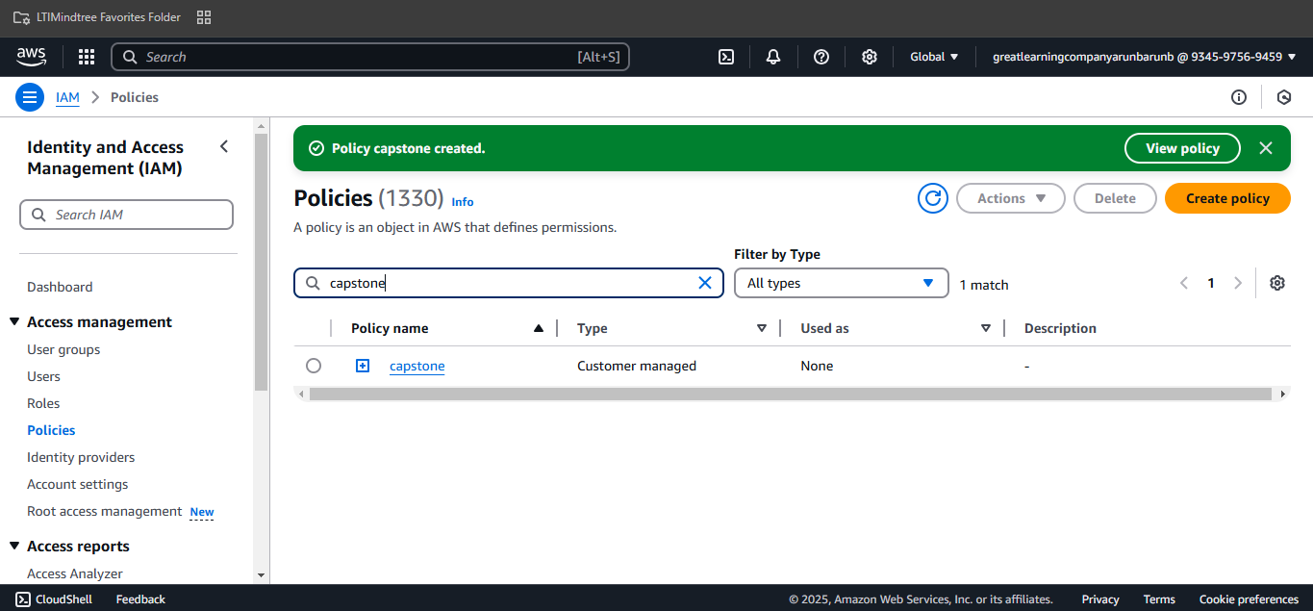
IAM policy created

Slide 14
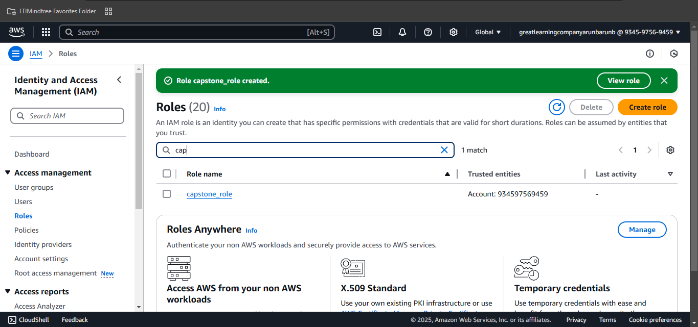
IAM role created

Slide 15
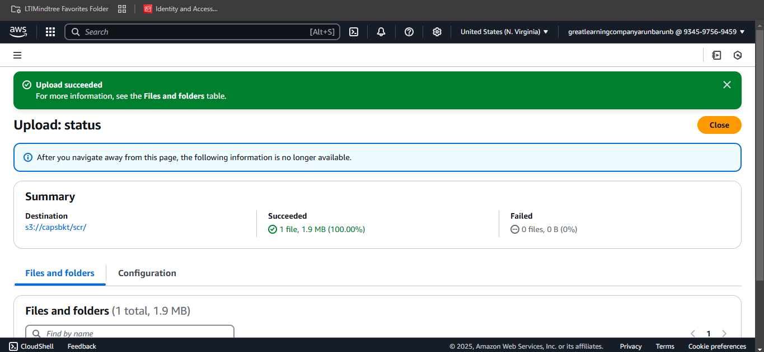
Dataset uploaded in the s3

Slide 16
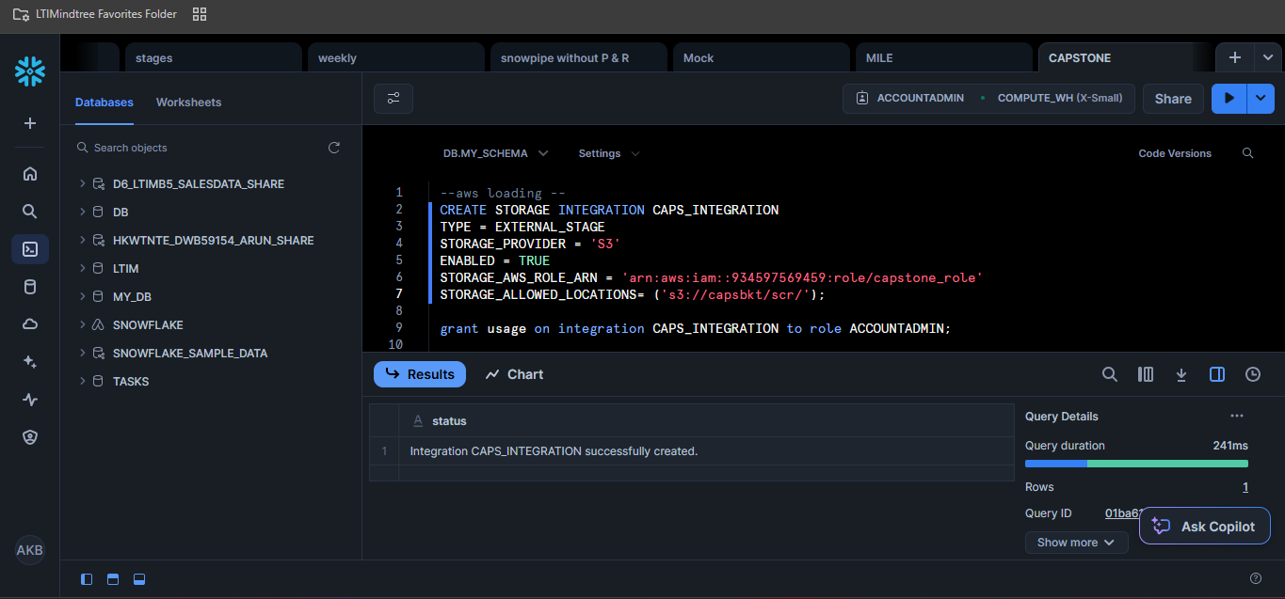
Storage Integration created

Slide 17
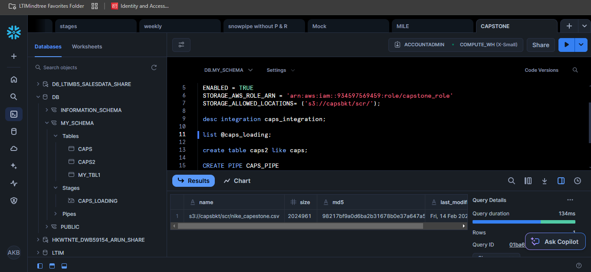
Dataset loaded to stage through data integration

Slide 18
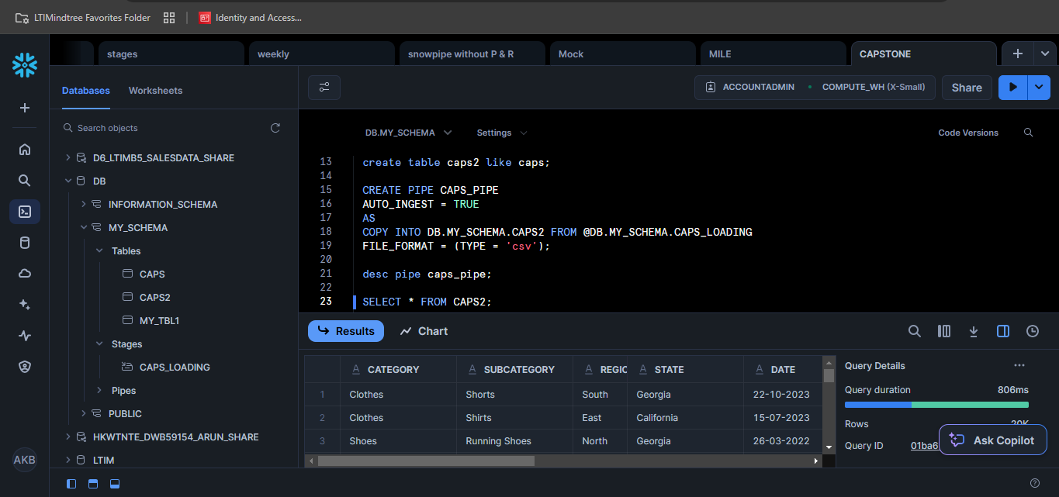
Table loaded automatically

Slide 19
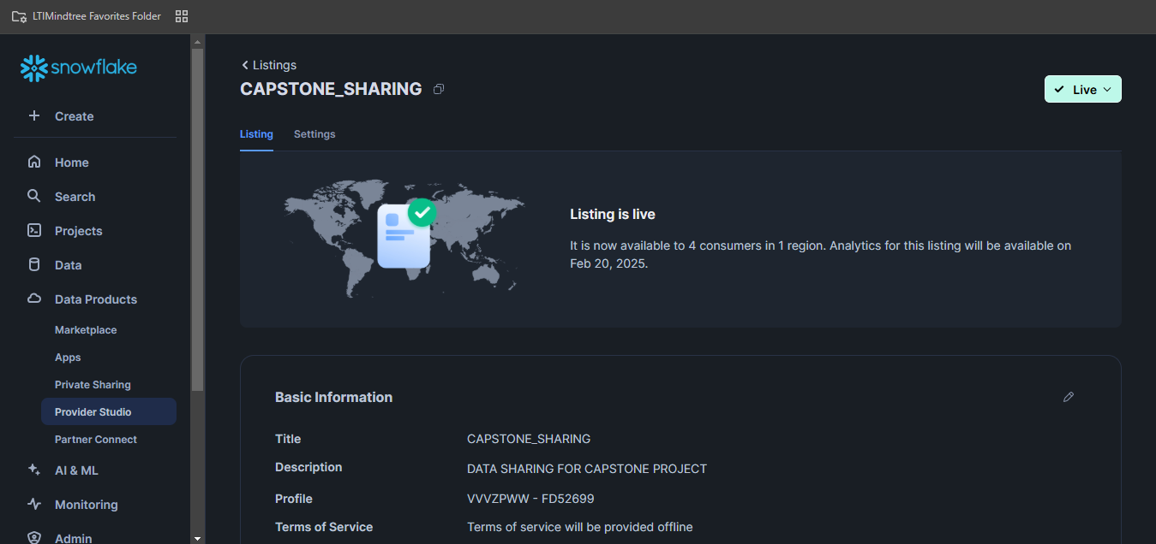
Data Sharing

Slide 20
TABLEAU VISUALIZATIONS:

Slide 21
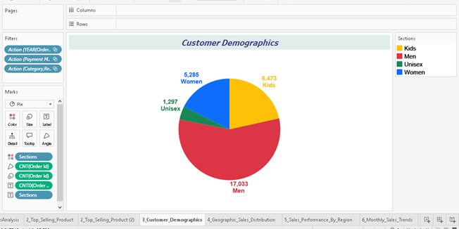
1. Customer Demographics - Pie chart of customer distribution by age group

Slide 22
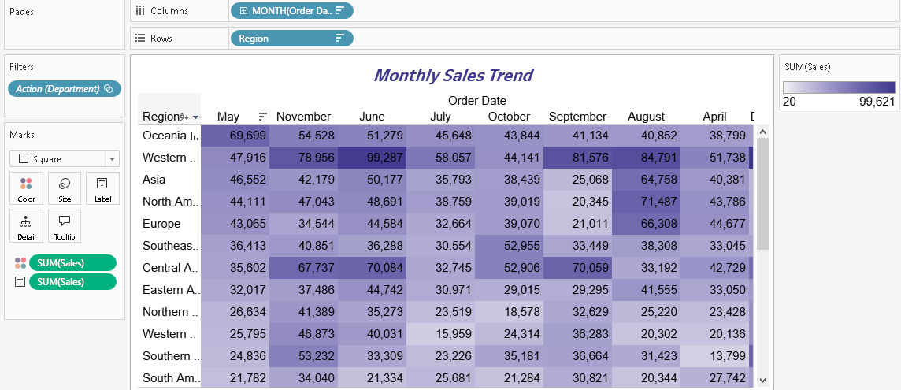
2. Monthly Sales Trends - Heatmap by month

Slide 23
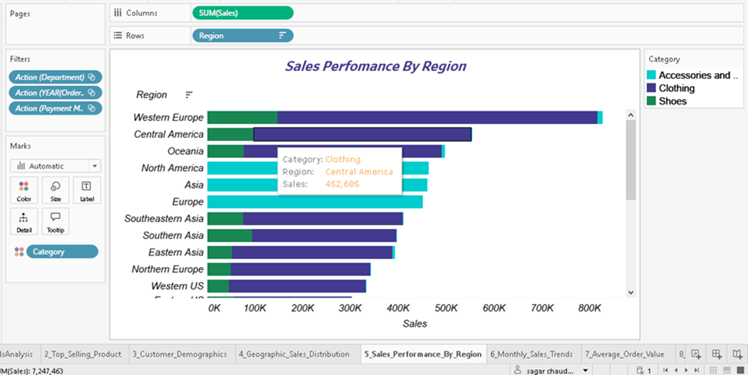
3. Sales Performance by Region - Stacked bar chart

Slide 24
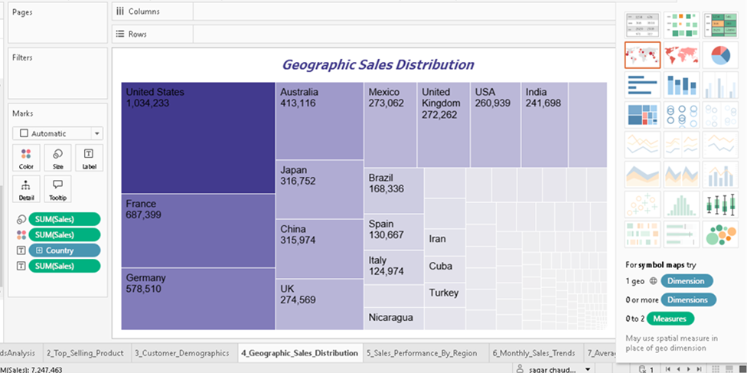
4. Geographic Sales Distribution - Map visualization

Slide 25
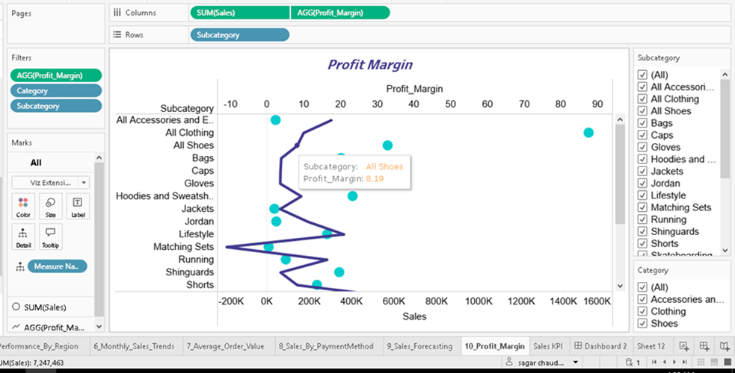
5. Profit Margin Analysis - Scatter plot

Slide 26
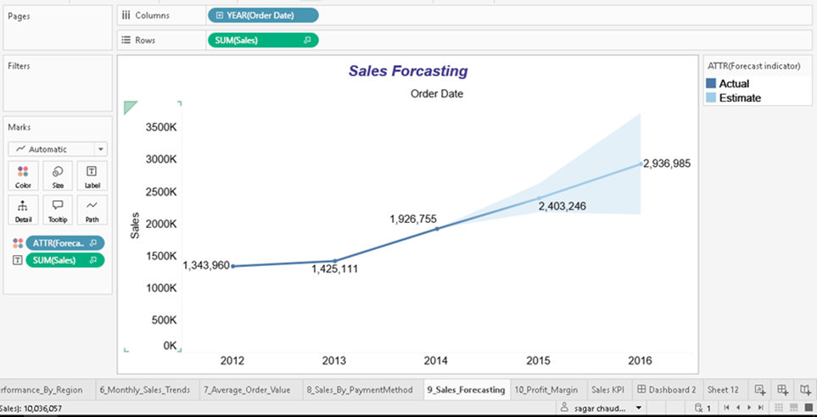
6. Sales forecasting - future sales based on historical data market trends

Slide 27
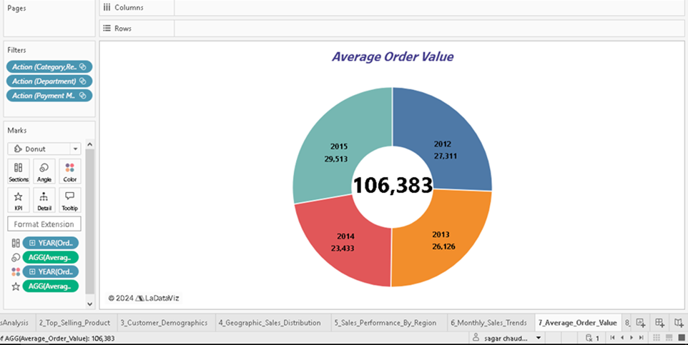
7. Average Order Value - Box plot or Bar Chart

Slide 28
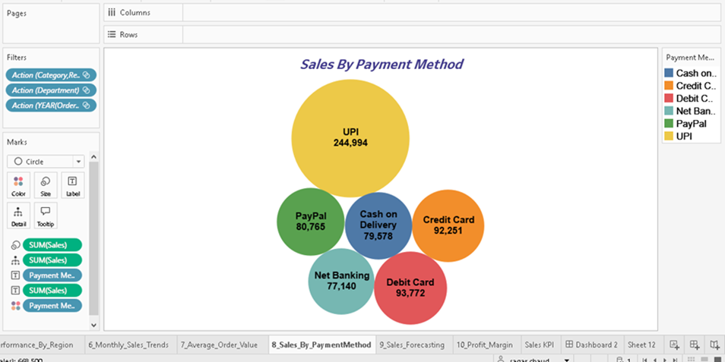
8. Sales by Payment Method - Stacked column chart

Slide 29
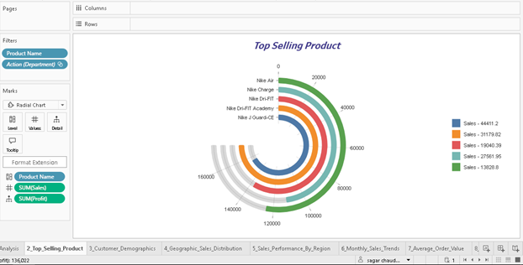
9. Top-Selling Products - Bar chart displaying the top 5 products

Slide 30
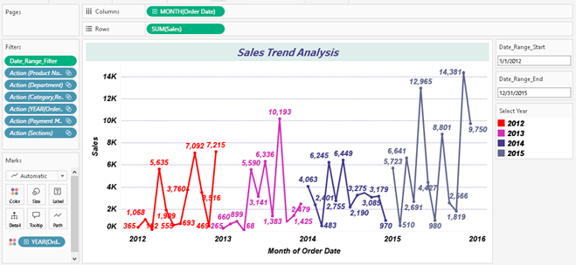
10. Sales Trends Analysis Line chart of sales revenue over time

Slide 31
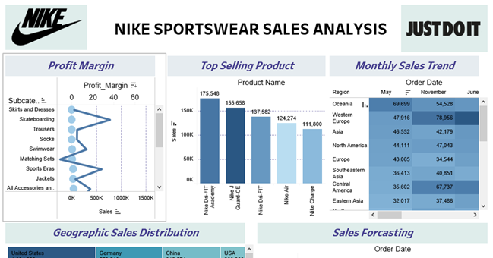
DASHBOARD 1:

Slide 32
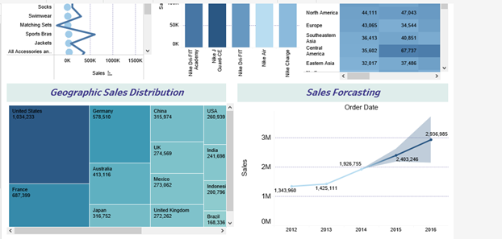

Slide 33
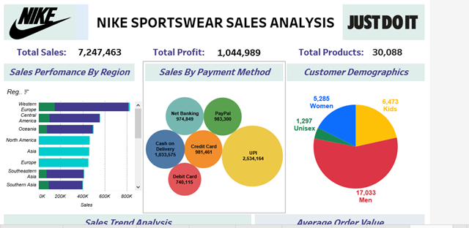
DASHBOARD 2:

Slide 34
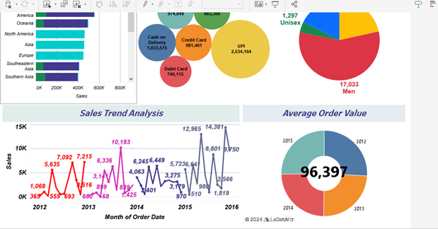

Slide 35
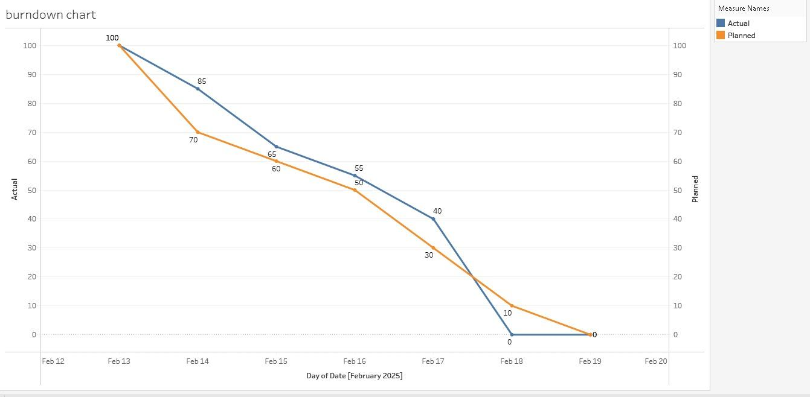
BURNDOWN CHART:

Slide 36
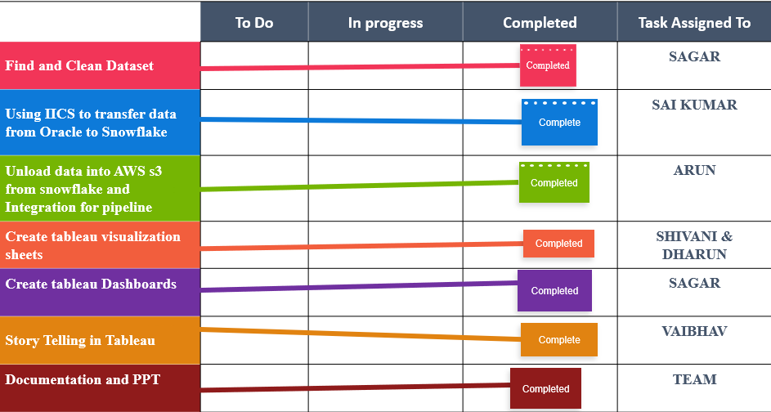
KANBAN CHART:

Slide 37
CONCLUSION:
Data securely stored in AWS S3 and processed using Snowflake.
Visualized sales trends, top products, customer demographics, geographic distribution, and payment methods.
Analysis aids in optimizing sales strategies and supports strategic planning for growth and profitability.

Slide 38
THANK YOU

